Slide 1
UBC Dentistry
COVID-19 Phase 2
Clinic Protocol
Revised on June 20, 2020
This protocol is aligned with the Return to Non-Essential Care Guidelines as determined by the Dental Regulators and the BC Ministry of Health.

Slide 2
Introduction
Regulatory, Health and Safety Guidelines (document links issued)
Additional Links to Important Information
Guiding Principles
Ongoing Pandemic Best Practices
Personal Protective Equipment
Infection Control Principles and Strategies
UBC Dental Clinic Protocols
Urgent Care Clinic Protocol for DMD and Geriatric Programs
Contents

Slide 3
When the British Columbia Ministry of Health declared Phase 1 measures to contain COVID-19 pandemic, it became necessary to develop additional Infection Prevention and Control Protocols to safely provide patient care at UBC Faculty of Dentistry. These protocols were aligned with those determined by the dental regulators, augmented by the collaboration with other Dental Schools and regularly improved by the valuable input and work of our staff and faculty members.
With the province currently in Phase 2, oral care has expanded from emergent and urgent treatment to include non-essential treatment. This document describes the guidelines that allow faculty and students enrolled in the Faculty’s clinical programs to safely provide care.
Clinical activities are to increase incrementally in order to assist the continuous review of the protocols’ effectiveness and to provide opportunity for refinement. On-going monitoring of government, regulators and scientific publications assists to maintain our practice current. Much appreciated is also the feedback provided by our community at the UBC Faculty of Dentistry
Introduction

Slide 4
Transitioning Oral Healthcare to Phase 2 of the COVID-19 Response Plan
May 15, 2020
This document is a shared document between the College of Dental Hygienists of BC, the College of Dental Surgeons of BC, the College of Denturists of BC and the College of Dental Technicians of BC.
It provides oral health care specific information regarding a resumption of the provision on non-essential care.
https://www.cdsbc.org/Documents/covid-19/Transitioning-Oral-Healthcare-to-Phase-2.pdf
https://www.cdhbc.com/News-Events/COVID-19/FAQ-Transitioning-OHCP-to-Phase-2-May-21,-2020.aspx

Slide 5

Letter from Provincial Health Officer Regarding Return to Non-Essential Care
Additional Links to Important Information
Dr. Henry has provided a letter to health care professionals regarding a resumption of the provision of non-essential health care services. This letter also contains links to supporting guidelines from the BCCDC and Worksafe BC.
https://www.cdhbc.com/News-Events/COVID-19/Message-to-Health-Professionals-from-the-PHO-15-Ma.aspx
COVID-19: Infection Prevention and Control Guidance for Community-Based Allied Health Care Providers in Clinic Settings May 15, 2020
http://www.bccdc.ca/Health-Professionals-Site/Documents/COVID19_IPCGuidelinesCommunityBasedAlliedHCPsClinicSettings.pdf
Infection Prevention and Control (IPC) Protocol for Surgical Procedures During COVID-19: Adult
http://www.bccdc.ca/Health-Professionals-Site/Documents/COVID19_IPCProtocolSurgicalProceduresAdult.pdf
Health Professions: Protocols for returning to operation
https://www.worksafebc.com/en/about-us/covid-19-updates/covid-19-returning-safe-operation/health-professionals
Notes:
CDSBC Expectations and Pathway for Patient Care during the COVID-19 Pandemic (April 30, 2020) has been temporarily unpublished in light of the May 15 COVID-19 update for CDSBC registrants, so it is not included among the documents here as it was with the UCC Protocol. https://www.cdsbc.org/Pages/covid-19-info.aspx

Slide 6
Guiding Principles
All Oral Health Care Providers (OHCP) will follow the guidance, expectations, and direction provided by the Provincial Health Officer (PHO).
Some services can be safely and effectively provided virtually. Other services require in-person visits including direct patient care. Oral health college standards and guidelines apply, regardless of whether services are provided virtually or in-person.
The OHCP is accountable and is the person best positioned to determine the need for, urgency and appropriateness of in-person care.
Appropriate personal protective equipment (PPE) must be used for the safe delivery of in-person care. However, all Oral Health Care Providers (OHCPs) must also act to conserve PPE through its judicious use.
OHCPs must not recommend unproven therapies for treating COVID-19.
OHCPs must not prescribe or offer any COVID-19 treatments or therapies that are not within their scope of practice.
OHCPs are accountable to provide clear, honest, transparent communication regarding their policies and procedures related to COVID-19.

Slide 7
Ongoing Best Pandemic Practices
Increase screening for signs, symptoms and risk factors for COVID-19
Must not provide in-person care and should not be in attendance at clinics or other practice settings where other staff and patients are present if they are exhibiting signs of COVID-19 or respiratory illness, including cough, runny nose or fever.
Follow BCCDC and WorkSafeBC guidelines for self-isolation when an employee is sick with any respiratory illness, support access to primary care provider assessment and testing, and provide sick-leave support where possible until advised by their health care provider that it is safe to return to work.
Implement COVID-19 screening practices for patients:
  Patients should also be encouraged to make use of COVID-19 resources by calling 811 or visiting healthlinkbc.ca
  Screen for risk factors and symptoms of COVID-19 prior to attendance at the practice environment. If patient screening reveals risk factors for COVID-19 or symptoms of COVID-19, defer patient care (where reasonable) until signs and symptoms have resolved.
Notes:
1 - Dr. Esteves and Kathy, would you like the wording of this changed or qualified to include students, instructors and visitors?

Slide 8
Infection Prevention and Control (IPAC) Principles and Strategies
Maintain routine practices
Physical adaptations within the clinic
Hand hygiene
Risk assessment with focus on aerosol and droplet management and contact precautions
IPAC principles include:
  Patient assessment
  Implementation of routine procedures
  Use of barrier techniques to protect patients, OHCPS and staff
  Application of the principles of cleaning, disinfection, sterilization and storage of dental instruments
  Environmental surface protection/cleaning
  Care of overall office setting; and
  Safe handling and disposal of waste
An IPAC strategy to reduce the possibility of disease transmission includes:
  setting specific policies and procedures to identify, communicate and implement effective standards and guidelines;
  written office policies and programs for effective occupational health and safety;
  educating OHCPs, staff and patients about their roles in infection prevention; and
  ongoing review and evaluation of IPAC policies and procedures.

Slide 9
UBC Dental Clinic Protocols

Slide 10
Patient Management and Safety
Pre Screening Protocols
High-risk Patients
Patients considered high risk for severe COVID-19 include those with pre-existing conditions such as
  serious respiratory disease,
  serious heart conditions,
  immunocompromised conditions,
  severe obesity,
  diabetes,
  chronic kidney disease or those undergoing dialysis, and
  liver disease;
  pregnant patients; and
  patients who are 70 years and over.
These patients should be deferred whenever possible.
Staff Requirements
Staff must maintain awareness of data on the local and regional spread of COVID-19.
Staff conducting telephone screening are provided with appropriate guidance on
  how to screen for signs and symptoms of COVID-19,
  when to advise patients to self-isolate at home,
  how to counsel them on signs and symptoms of more severe or critical illness that should prompt them to seek emergent care, and
  on the indications and locations for testing.
On-site administrative staff who are screening patients must be behind a transparent barrier that prevents droplet transmission and allows for communication between staff and patients, or if this is not in place they must wear PPE
Please consult with your respective Program Directors /Clinical Advisors for individual case management.

Slide 11
Patient Screening Protocols
Prior to booking an appointment, the patient must be screened for COVID-19 risk by using the Patient Screening and Consent Form (page 12)
This includes asking patients:
  if they have symptoms of COVID-19
  if they have had close contact or have been in isolation with a suspected case in the last 14 days
  if they have travelled internationally in the last 14 days
When the patient arrives for their appointment, their pre-screening responses must be confirmed and recorded in their record
If the patient has symptoms of COVID-19 and may be infective, in-person assessment and treatment must be deferred or alternatively provide care by virtual means.
If the patient is COVID-positive, treatment should be provided in a hospital or tertiary care facility
Along with the screening form, the Personal Contact Log Form must be filled for each appointment
Once completed, both forms must be uploaded into the patient record in Romexis

Slide 12
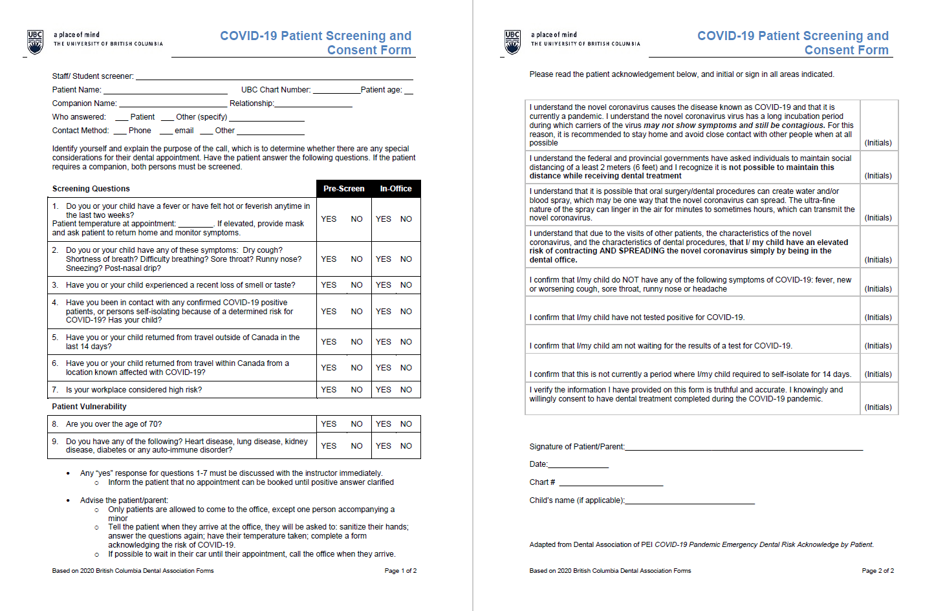
Patient Screening and Consent Form

Slide 13
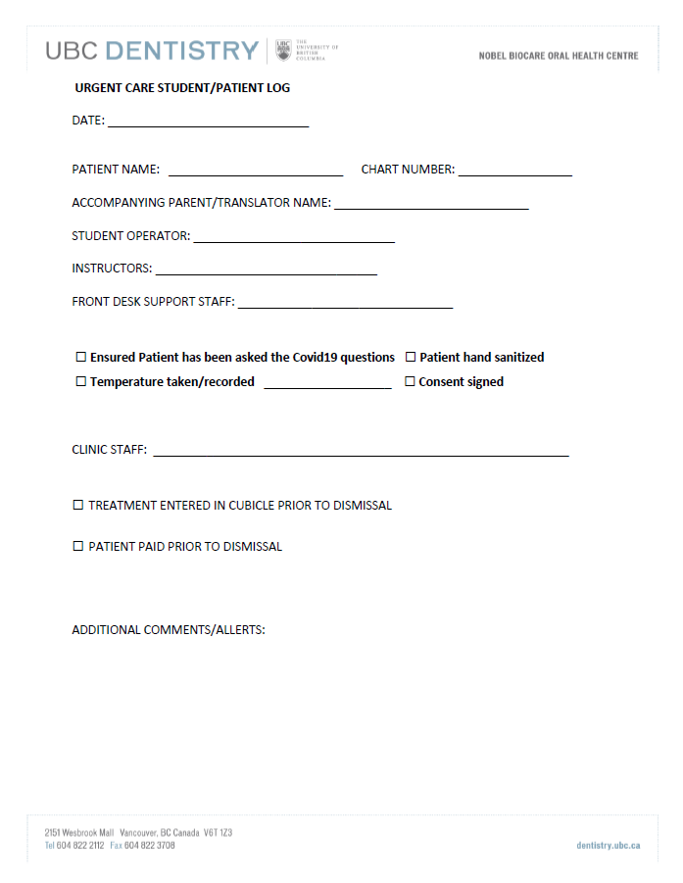
Personal Contact Log Form

Slide 14
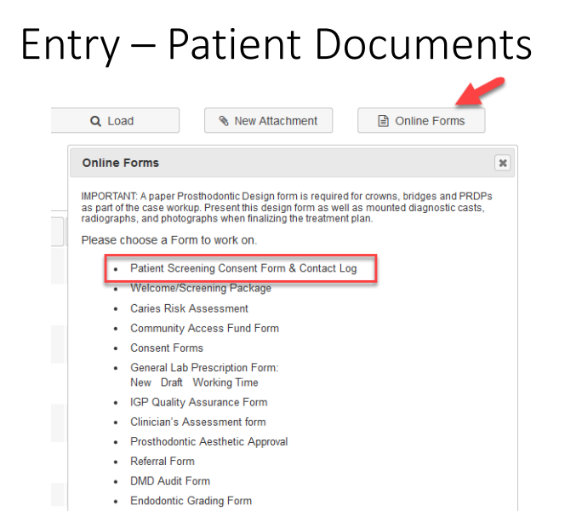
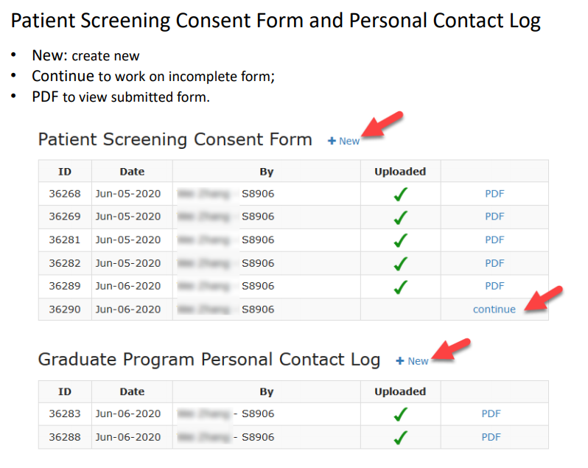
How to Access Screening Consent & Personal Contact Log Forms Electronically
1
2

Slide 15
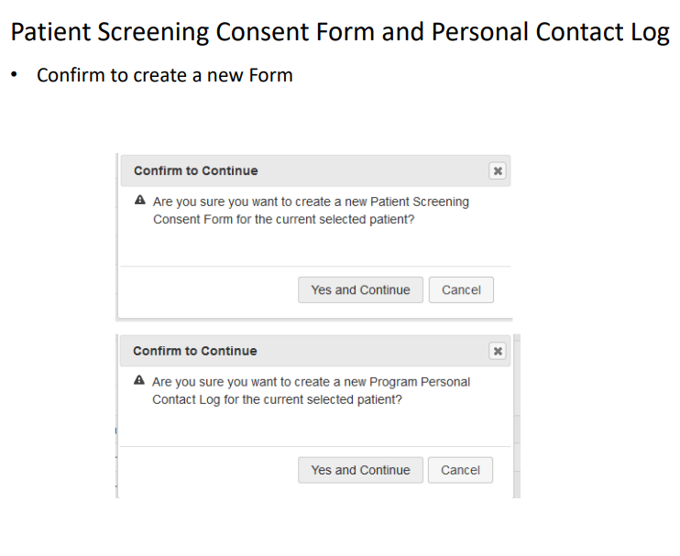
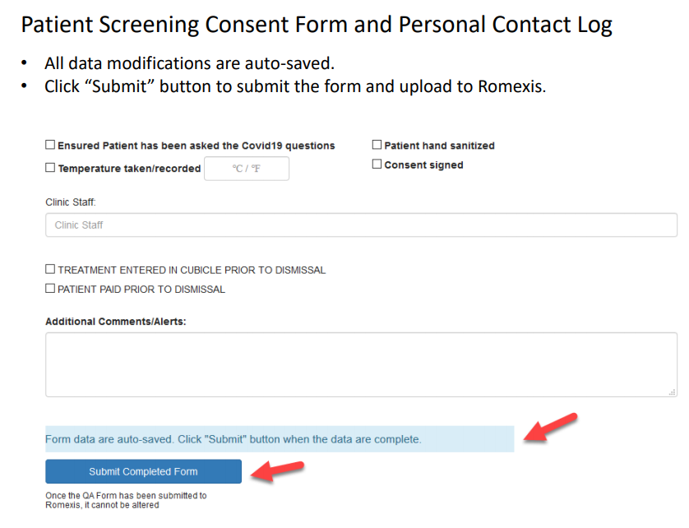
How to Access Screening Consent & Personal Contact Log Forms Electronically (continued)
3
4

Slide 16
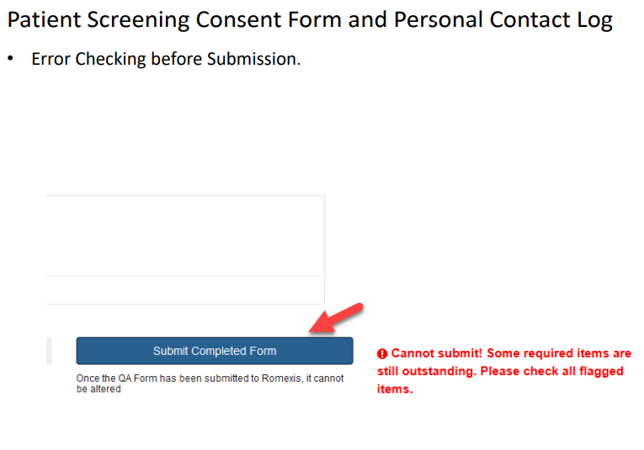
How to Access Screening Consent & Personal Contact Log Forms Electronically (continued)
5

Slide 17
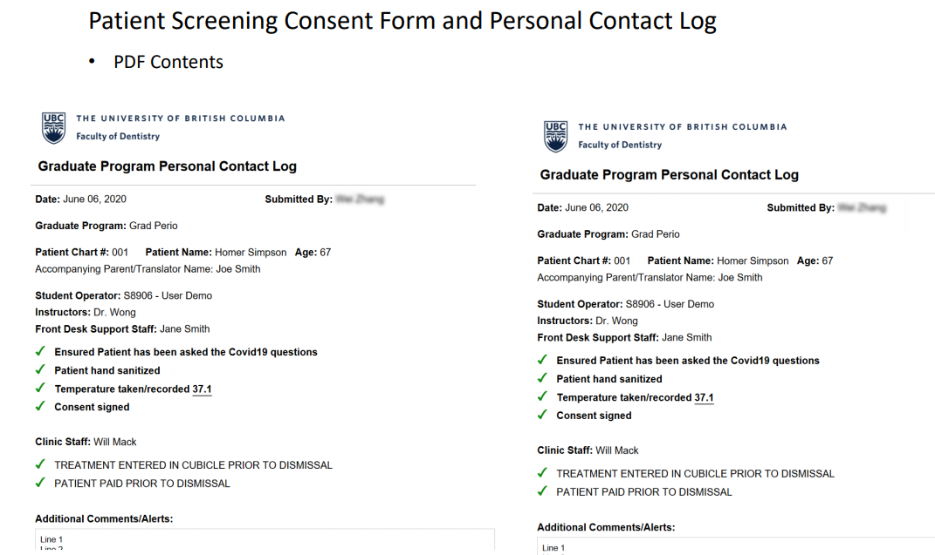
How to Access Screening Consent & Personal Contact Log Forms Electronically (continued)
6

Slide 18
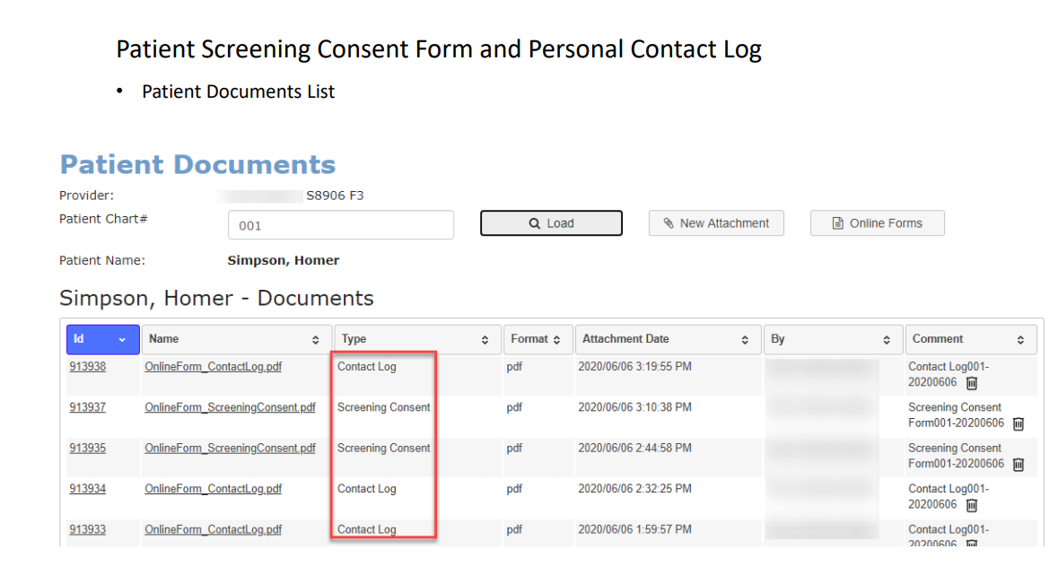
How to Access Screening Consent & Personal Contact Log Forms Electronically (continued)
7

Slide 19
Temperature Screening and
Informed Consent
Patients are encouraged to attend the clinic wearing a mask and must perform hand salinization at arrival. A mask is provided if not in use.
Once arrived, have patient proceed to designated Temperature Screening Station at ground floor clinic entrance.
Greeter/Triage Person opens the door for the patient.
Screen patient for signs of acute respiratory illness – ask questions from COVID-19 Patient Screening and Consent Form
Direct patient to temperature taking station
  Patient is asked to sanitize hands, then to open Tempodot, wear overgloves and self-measure temperature (show visual instructions in cart)
  Set 1 minute timer
  Check temperature reading and record the patient’s temperature.
  Ask patient to discard Tempodot in paper bag
  Inform the provider of the patient’s responses to the screening questions and the temperature reading. The provider enters patient responses on the electronic screening form and obtains the patient’s electronic signature.
Alternately, may use NCIT (thermometer gun) for temperature taking and record his/her temperature . See next slide for instructions.
If pediatric patient or geriatric patient is accompanied by parent/caregiver, take temperatures of both child /geriatric patient and parent/caregiver. Record both.
Notes:
Need Dr. Esteves, Kathy, Michele to recheck this for correctness; Geriatric patient added to the information above Geri patients will be seen at UCC

Slide 20
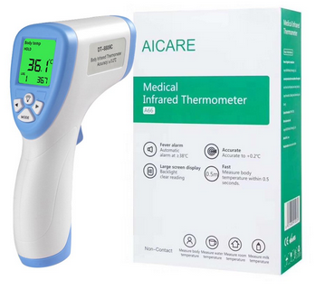
Temperature Cart/Station
NCIT (Non Contact Infrared Thermometer)
Medical Infrared Thermometer AICARE Model: A66
Reference Value of Body Temp
Forehead: 36 - 37.2 Celsius
Posterior Earlobe: 35.8 - 38 Celsius
AGE:
0-2 yrs: 36.4 - 38.0 Celsius
3-10 yrs: 36.1 - 37.8 Celsius
11-65 yrs: 35.9 - 37.6 Celsius
65<yrs: 35.8 - 37.5 Celsius
Body temp of women is different from men. Generally, 0.3 Celsius higher than that of men. During ovulation, the body temp will be 0.3 - 0.5 Celsius higher than the usual temperature.
TROUBLESHOOTING:
If display has "Lo" or "Hi" rather than data.
This means that the patient's temperature is not within the range of the human temperature measuring mode values.
Reasons for displaying information "Lo" or "Hi"
The temperature value is affected by hair and sweat. ---Staff should ensure there are no obstacles when measuring the temperature.
The temperature is affected by airflow change. ---Staff should ensure stable air during temperature measurement.
The measuring distance is too far. ---Staff should note that the measuring distance is in the range of 5-10 cm or 1.9 to 3.9 inches.
Walking indoors from outdoor with low temperature or high temperature. ---Staff should wait for 20 minutes and measure the body temperature after the tested person adapts to the measuring environment.

Slide 21
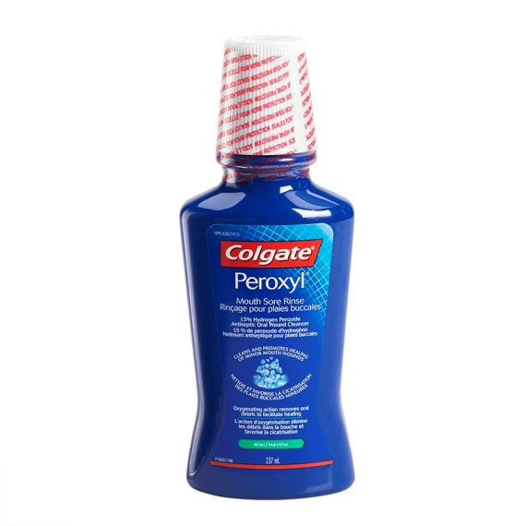
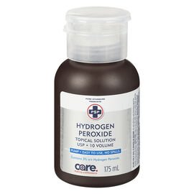
Preprocedural rinse
The ‘Transitioning Oral Health Care to Phase 2’ document is silent on pre-procedural rinses: The College states that the literature does not yet provide sufficient evidence to support a guideline for the use of a pre-procedural rinse as an efficacious means of reducing COVID-19 viral load in aerosols. OHCPs may choose to offer such procedures but are encouraged to align their practices with evidence-informed guidelines related to COVID-19.
Our clinic uses 1.5% hydrogen peroxide as a preprocedural rinse.
Chlorhexidine may NOT be effective in killing Covid-19 virus
Since CoVid-19 vulnerable to oxidation, preprocedural mouthrinse containing oxidative agents such as 1% hydrogen peroxide or 0.2% povidone is recommended
Per Faculty consult, best to avoid povidone iodine due to allergy risk
Currently using Colgate Peroxyl contains 1.5% hydrogen peroxide rinse
Patient instructions: Gargle and swish the mixture around in your mouth for 60 seconds (use a timer or count silently to 60). Spit the solution out after gargling. Don’t try to gargle the mixture for more than 90 seconds.
To mix own mouthwash: Start with a 3% concentration of hydrogen peroxide. This is the strength you’ll find in a brown bottle at most drug stores. Next, combine one part hydrogen peroxide with two parts water. Your final mix will have a concentration of 1% hydrogen peroxide. We have 3% hydrogen peroxide in the CSD-R shelves.

Slide 22
Routine Practices
Risk Assessment
Risk assessment must be done before each in-person interaction to determine the interventions required to prevent disease transmission.
Prior to any contact with the patient, the OHCP and staff must assess the infectious risk posed to themselves, other OHCPs, staff and patients. The risk will vary with the context of the patient and the type of procedure being contemplated. It is based on the OHCP’s professional judgment and must take into consideration the physical environment, including any possible facility limitations, and the resources available, including PPE, in order to safely treat patients.
Personal PPE for Patients
Routine protective measures must be provided for patients:
Bibs
Eye protection
Hand Hygiene
Hand hygiene is the single most important measure for preventing disease transmission.
  Hand hygiene must be performed
  When in the patient care environment
  Before and after direct contact with a patient
  Before procedures
  After risk of body fluid exposure
  Before donning gloves and immediately after removing gloves
  Before and after mask use
  After contact with environmental surfaces
  After contact with laboratory materials or equipment and
  When hands are visibly soiled
Patients must perform hand hygiene with soap and water or with an alcohol based hand rub (ABHR)
  After removing a mask or other PPE
  Coughing
  Sneezing
  Using a Tissue or
  When hands are visibly soiled

Slide 23
Exposure Prevention
The majority of exposures are preventable by following routine procedures. Where there is low incidence and prevalence of COVID-19, additional PPE over and above that required for normal precautions is not required. (BCCDC).
Aerosol-generating medical procedures (AGMPs)
An AGMP is any procedure conducted on a patient that can induce production of aerosols of various sizes, including droplet nuclei.
PPE for OHCPs and Staff
Every effort is made to make PPE available and accessible at the point-of-care with patient
OHCPs must receive training in and demonstrate an understanding of
  When to use PPE
  What PPE is necessary
  How to properly don, use and doff PPE in a manner to prevent self-contamination
Safe donning and doffing practices must be followed.
PPE should be removed in the following order: gloves, gown, protective eyewear, faceshield, mask and perform hand hygiene immediately afterwards. Hand hygiene should occur according to best practices for putting on and removing PPE.
Change into separate set of street clothes and footwear before leaving work. Work clothing (e.g., scrubs) should be placed in a bag and laundered after every shift. Shower immediately upon returning home after every shift.
  PPE Storage
  PPE is stored to avoid pilfering, while not inhibiting staff from accessing PPE.
  There is regular assessment to determine stock of necessary PPE (e.g. gloves, gowns, masks, eye protection) and necessary supplies including ABHR.
  Appropriate number and placement of ABHR dispensers, at entry to the outpatient and community-based care setting, in hallways at entry to each exam room, communal areas and at point- of-care for each patient
  Respiratory hygiene products (e.g., masks, tissues, ABHR, no-touch waste receptacles) are available and easily accessible to staff and patients
  Managing Droplet and Spatter
  High-volume suction must be used to reduce aerosols at source.
  A rubber dam should be used whenever possible, with high-volume suction in procedures where the creation of droplets, splatter and spray may occur.
  Unnecessary equipment and items must be removed from the operatory.
  Countertops and touched surfaces should be clear to enable covering with barriers and/or thorough cleaning and disinfection, decreasing opportunities for transmission.

Slide 24
Personal Protective Equipment (PPE)
Regarding use of personal protective equipment (PPE), OHCPs should follow the directives and recommendations provided by BCCDC, PICNet, and WorkSafeBC. This includes directives that are role-based (e.g. administrative vs. direct patient contact) or specific to the practice context (e.g. mobile practice in long term care settings vs. community-based facilities).
PPE recommended to be used in the context of COVID-19 disease has been presented at Table 1. At UBC Oral Health Clinics, safety glasses OR goggles with a faceshield are used as eye protection equipment for DHCPs when there is COVID-19 infection occurring in the community.

Slide 25
Table 1 : Recommended type of PPE to be used in the context of COVID-19 disease, according to the setting, personnel and type of activity (Adapted from: World Health Organization. "Rational use of Personal Protective Equipment for Coronavirus Disease 2019 (COVID-19)." February 27, 2020: 1-7)
Non-COVID 19 Patients
Patient Room | Dentists/ Providers | Aerosol-generating procedures (AGP) | Level 3 Mask Faceshield Eye Protection High Level Gown Gloves Bouffant/Hair Cap
 |  | Providing direct care (non-AGP) | Level 3 Mask Faceshield Eye Protection Gown/Lab Coat Gloves
 | Disinfecting treatment rooms | Entering the room Wait 30 minutes before disinfecting treatment room. (per Dr. Esteves 6/1/2020) | Level 3 Mask Eye Protection Faceshield Fluid Resistant Gown Gloves Bouffant/Hair Cap
 | Visitors | Entering the room | Level 1 Mask
Other Areas of Patient Transit | All Staff | Any activity that does not involve contact with the patients | Level 1 Mask
Triage | Door greeter/Triage | Preliminary screening (vitals, hydrogen peroxide rinse) | Level 1 Mask Eye Protection Gown/Lab coat Scrubs Gloves Maintain spatial distance of 2 meters
 | Patient at triage presenting with COVID-19 symptoms or risk factors | Any | Provide Level 1 Mask If mask is not tolerated, patient to hold tissue over mouth Direct patient to UBC Hospital Maintain spatial distance of at least 2 meters
 | Patients without respiratory symptoms | Any | Ask patient to bring their and wear their own mask or provide level 1 mask

Slide 26
Clinic Protocol
Room preparation:
Clean and disinfect the room and equipment according to the UBC Infection Prevention & Control protocol.
Use products with EPA-approved emerging viral pathogens claims.
Clean, disinfect, or discard the surface, supplies, or equipment located within 6 feet of patients.
Use dental barriers to cover dental chairs, operator and assistant chairs, handpiece console, saliva ejector, HVE, A/W syringe, microscope, computer monitor, keyboard, phone, x-ray head, light handles, pen, door handles, etc.
**Patients should NOT be touching door handles. Staff should be opening all doors for patients.
Adhere to Standard and Transmission-Based Precautions
Hand Hygiene
  HCP should perform hand hygiene
    before and after all patient contact,
    contact with potentially infectious material, and
    before putting on and after removing PPE, including gloves.
  Hand hygiene after removing PPE is particularly important to remove any pathogens that might have been transferred to bare hands during the removal process.
  HCP should perform hand hygiene by using Alcohol-Based Hand Rub (ABHR) with 60-95% alcohol or washing hands with soap and water for at least 20 seconds. If hands are visibly soiled, use soap and water before returning to ABHR.
  Healthcare facilities should ensure that hand hygiene supplies are readily available to all personnel in every care location.
Personal Protective Equipment
Facemask
Put on a facemask before entry into the patient room or care area.
Facemasks should be removed and discarded after exiting the patient’s room or care area and closing the door.
Perform hand hygiene after discarding the facemask.
Eye Protection
Put on eye protection (goggles and a faceshield that covers the front and sides of the face) upon entry to the patient room or care area. Personal eyeglasses and contact lenses are NOT considered adequate eye protection.
Remove eye protection before leaving the patient room or care area.
Reusable eye protection (e.g., goggles , faceshields) must be cleaned and disinfected according to manufacturer’s reprocessing instructions prior to re-use. Disposable eye protection should be discarded after use.
Gloves
Put on clean, non-sterile gloves upon entry into the patient room or care area.
  Change gloves if they become torn or heavily contaminated.
Remove and discard gloves when leaving the patient room or care area, and immediately perform hand hygiene.
Gowns
Put on a clean isolation gown upon entry into the patient room or area. Change the gown if it becomes soiled. Remove and discard the gown in a dedicated container for waste or linen before leaving the patient room or care area. Disposable gowns should be discarded after use.
Wear disposable doctor cap
Notes:
This is sourced from the UCC protocol and it was several pages before consolidated into one

Slide 27
Steps for putting on (donning) personal protective equipment
Hand Hygiene
Hand hygiene – Clean all surfaces of hands and wrists.
Bouffant
Gown – Cover torso and wrap around back, fasten in back of neck and waist.
Surgical/procedure mask – Secure ties in middle of head and neck, fit nose band to your nose and pull on bottom down to completely cover chin.
Eye protection – Place goggles and faceshield over eyes and face and adjust to fit.
Hand hygiene – Clean all surfaces of hands and wrists
Gloves – Extend to cover wrist of gown
Reference:
http://www.bccdc.ca/Health-Professionals-Site/Documents/COVID19_MOH_BCCDC_Donning.pdf
Video tutorials:
https://ahamms01.https.internapcdn.net/ahamms01/Content/AHS_Website/Information_For/if-hp-ipc-donning-and-doffing.mp4
https://ahamms01.https.internapcdn.net/ahamms01/Content/AHS_Website/modules/ipc-guide-to-ppe-update/story_html5.html
Bouffant On
Isolation Gown On
Surgical Mask On
Goggles and FaceShield On
Hand Hygiene
Gloves On
Extend to cover wrist of gown

Slide 28
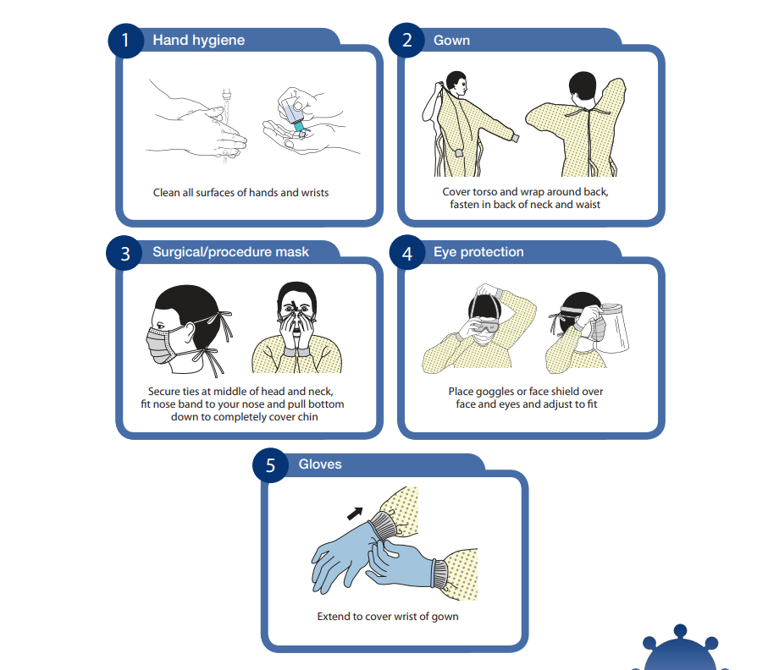
Place goggles and faceshield over eyes and face and adjust to fit
5
6

Slide 29
Steps for taking off (doffing) personal protective equipment
Gloves OFF
Hand Hygiene
Gown OFF
Gloves - The outside of gloves are contaminated. Grasp palm area of one gloved hand and peel off first glove. Slide fingers of hand under other glove at wrist and peel off. Discard in lined biohazard bucket.
Perform hand hygiene - Clean all surfaces of hands and wrists.
Gown - Unfasten ties, pull gown away from neck and shoulders, touching ONLY the inside of the gown. Turn gown inside out and roll into a bundle. Place in soiled laundry hamper (if reusable) or in lined biohazard bucket (if disposable).
Perform hand hygiene - Clean all surfaces of hands and wrists. If you are NOT 2 meters away from the patient, exit room now, perform hand hygiene, and finish the remaining steps.
Goggles and faceshield - Do NOT touch the front of the eye wear. Place in receptacle for reprocessing (if reusable) or in lined biohazard bucket (if disposable).
Perform hand hygiene - Clean all surfaces of hands and wrists.
Surgical or procedure mask - Grasp ties or elastics at back and remove WITHOUT touching the front. Place in receptacle for reprocessing or in lined biohazard bucket.
Perform hand hygiene - Clean all surfaces of hands and wrists.
Exit room: Exit room and perform hand hygiene.
Reference:
http://www.bccdc.ca/Health-Professionals-Site/Documents/COVID19_MOH_BCCDC_Doffing.pdf
Video tutorials:
https://ahamms01.https.internapcdn.net/ahamms01/Content/AHS_Website/Information_For/if-hp-ipc-donning-and-doffing.mp4
https://ahamms01.https.internapcdn.net/ahamms01/Content/AHS_Website/modules/ipc-guide-to-ppe-update/story_html5.html
Hand Hygiene
Leave Room
Hand Hygiene
Eye Protection OFF
Without touching front
Bouffant OFF
Hand Hygiene
Mask OFF
Without touching front
Hand Hygiene
Notes:
DOFFING PPE for AGMP removed as this guideline shows removal of N95 respirator. Since clinic will not be using N95 respirators, then DOFFING procedure for non-AGMP and AGMP is the same.
Another change from previous protocol is that FACE SHIELD is doffed OUTSIDE of the treatment room. Group needs to discuss specific area where operators can doff contaminated face shields/goggles onto or into? Bin? Hang by the door?

Slide 30
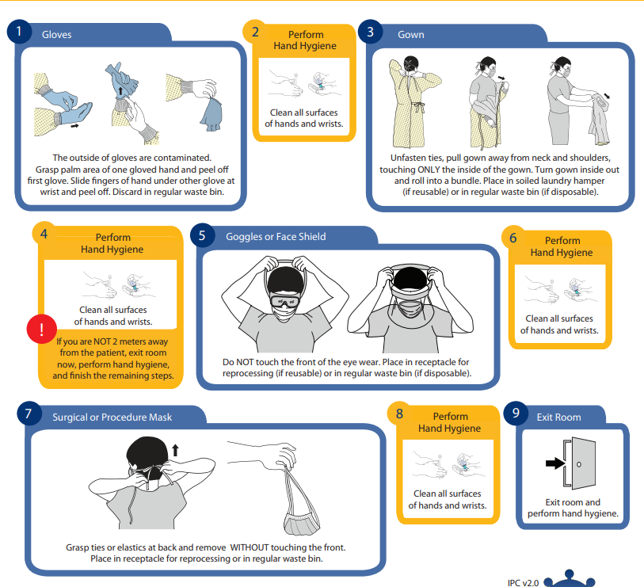
Goggles and FaceShield

Slide 31
Cleaning and Disinfection Instructions for
Reusable Eye Protection (goggles, safety glasses, face shields without foam)
If reusable eye protection is visibly
contaminated or soiled:
If reusable eye protection is NOT visibly
contaminated or soiled:
1. Don new pair of exam gloves.
2 . Using a clean cloth, wipe with soap and water,
cleaning from the inside to the outside.
3. Rinse with water & DRY with a paper towel.
4. Using one OPTIM wipe at a time, thoroughly wipe the interior followed by the exterior of the facial protection as well as headband and strap.
5. Ensure all surfaces remain wet with disinfectant for at least 3 minute
6. With a new wipe, thoroughly wipe the interior followed by the exterior of the facial Protection, headband and strap again.
7. Wait for 3 minutes
8. Equipment may be rinsed with tap water if
visibility is compromised by residual disinfectant.
9. Allow to dry (air dry or use clean absorbent towel).
10. Remove gloves and perform hand hygiene.
11. Store in a designated clean area.
1. Don new pair of exam gloves.
2 . Using one OPTIM wipe at a time, thoroughly wipe the interior followed by the exterior of the facial protection as well as headband and strap.
3. Ensure all surfaces remain wet with disinfectant
for at least 3 minute.
4. With a new wipe, thoroughly wipe the interior followed by the exterior of the facial Protection headband and strap again.
5. Wait for 3 minutes.
6. Equipment may be rinsed with tap water if
visibility is compromised by residual disinfectant.
7. Allow to dry (air dry or use clean absorbent towel).
8. Remove gloves and perform hand hygiene.
9. Store in a designated clean area.

Slide 32
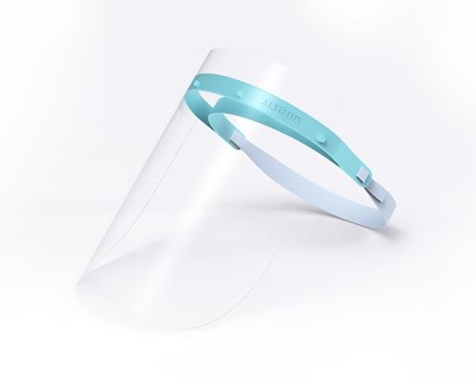
Reusable Face Shields
Every student, staff and faculty is provided with a reusable face shield. Monitor condition of face shield at each cleaning.
Replace clear plastic as needed.
Discard if broken.
Disinfection:
  Doff outside operatory.
  Clean with OPTIM wipes. Leave for 3 minutes.
  Disinfect with OPTIM wipes. Leave for 3 minutes.
  Rinse with water to remove streaks.
  Wipe dry with Kim wipes.

Slide 33
Facility Management (Office Cleaning, Housekeeping and Waste Management)
General Considerations
Facilities and laboratories should minimize access points.
Increased frequency of environmental cleaning and disinfection practices, including cleaning high-touch surfaces in patient exam rooms and any central areas is important for controlling the spread of microorganisms. Environmental disinfectants used should be classed as hospital-grade, registered in Canada with a Drug Identification Number (DIN), and labelled as effective for both enveloped and non-enveloped viruses.
Floors and walls should be kept visibly clean and free of spills, dust and debris.
Proper hand hygiene and use of PPE must be maintained during cleaning, house-keeping and waste management to effectively block transmission Staff training must be provided to ensure safe handling and effective application of cleaning products. Environmental cleaning and disinfection practices are monitored for compliance.
Reception/Waiting Area
There must be clear signage at entrance door, waiting room, reception, operatories and washrooms regarding physical distancing, hand hygiene and respiratory etiquette.
Decrease cloth and fabric surfaces, and remove fabric covered chairs.
Remove all unnecessary items from the waiting room, such as magazines and toys, and keep surfaces clear and clean.
Ensure shared equipment and facilities, such as telephones, computers, washrooms and laundry rooms receive increased cleaning and disinfection.
Separate waiting room chairs by at least 2 metres.
Clean surfaces and high-touch surfaces (door handles, chair arms, reception counter, etc.) regularly with a detergent with water or ready detergent wipes.
Areas of known contamination should be cleaned and disinfected.

Slide 34
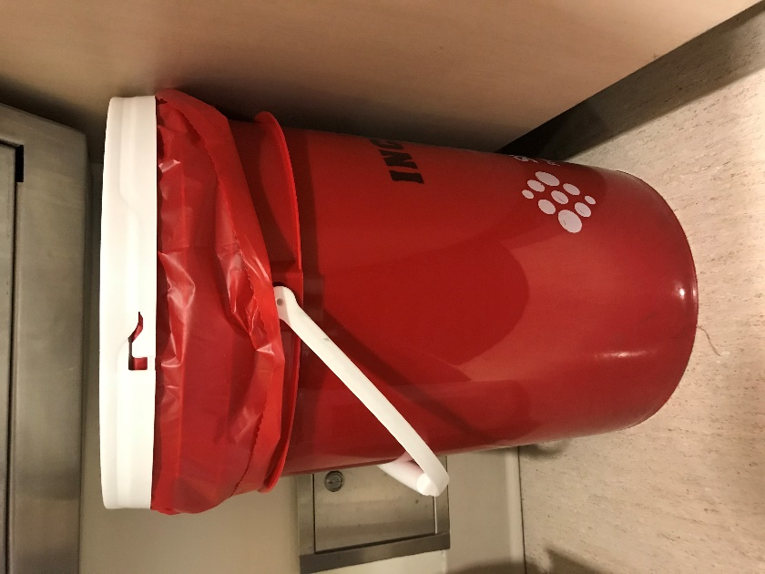
Disinfection of Operatories, Management of Instruments and Disposal of Medical Waste
Record time dental treatment is completed
Close the door of the operatory and put a do not enter sign
Disinfect the room after 30 minutes
Remove and discard all disposable items, barriers and place into lined biohazard bucket
  Dispose of all PPE into lined biohazard bucket provided.
  It is recommended that the blood bottle be placed in the bottom of the bucket.
  The buckets are small so you may have to use more than one bucket.
  Extra ones are stored in the laboratory across CSD-R.
Wipe all surfaces used with Optim and leave disinfectant for time specified by manufacturer
To disinfect instruments, saturate a paper towel or wipe placed over instruments with Optim and leave for time specified by manufacturer
Wipe down semi critical surfaces with Optim wipes
Repeat
Cover used instruments with used chair cover turned inside out before transport to CSD-R
Transport all used instruments to CSD-R
Disinfect all suction lines
Flush waterlines if handpieces used
Additional need for biohazard buckets have been anticipated for Graduate Endodontics (8-9) , Pedodontics (8), Prosthodontics (8), Periodontics (4) and Staff Hygiene (2). Graduate Orthodontics will be disposing into normal waste due to non-AGP procedures. (6/1/2020)

Slide 35
Disposal of Medical Waste (continued)
The blood bottle, if used, along with any other contaminated liquids, will be disposed of in the red biohazard bucket.
Allocated clinic staff will transport solids to Waste Storage Area located in Stores.
Kenneth Cheng’s Instructions:
Please put the bagged waste inside the biohazard red bucket and make sure you apply the yellow liner into the bucket before you disposing the waste. You can put blood bottle and solid waste into the same bucket too.
After the bucket is full, please tighten up the yellow liner with a plastic strip.
Then seal the bucket with its lid.
Please make sure you hammer down the lid properly, so that the bucket does not leak.
Finally you can attach the red tag (with G-ID label) onto each bucket, and send them to the hazardous waste storage area. Please do not check multiple box on the tag, you just need to check the highest risk group listed on the tag will be great. In your case, please check blood and body fluids (or even human anatomical if needed) on the tag will be fine.
It is important to ensure the buckets are sealed properly, no leaking or open bucket will be accepted (as usual). The lid will not be opened again after been sealed and these sealed buckets will send to special incinerator to burn.
Reference: E-mail exchange between Kelley and Kenneth Cheng
Kenneth Cheng
Technician | Environmental Services | Safety & Risk Services
The University of British Columbia | Vancouver Campus
6025 Nurseries Road | Vancouver BC | V6T 1W5 Canada
Tel: 604-827-5389 | Fax: 604-827-5087
kenneth.cheng@ubc.ca | srs.ubc.ca

Slide 36
Equipment and Area Specific Guidelines
Waterlines
Back flow prevention valves are required and flushing of water lines for 20-30 seconds before use in procedure and between patients.
Aerosol generating instruments
Use of aerosol generating instruments MUST be kept to a minimum.
  rotary handpieces which generate aerosols, regardless of whether the motor is electric or air- driven (with or without water)
  ultrasonic and sonic scalers
  triplex syringe
  air-abrasion and
  air-polishing
Handpiece
Consider the use of an anti-retraction dental handpiece or electric handpiece to reduce the risk of cross infection.
Disposable equipment and supplies
Single-use disposable equipment and supplies should be used whenever possible and discarded into a no-touch waste receptacle after each use. All reusable equipment should, whenever possible, be dedicated for use by one patient. If this is not feasible, equipment should be cleaned first and then disinfected or otherwise reprocessed according to manufacturer’s instructions and facility protocols.
Dental laboratory sepsis
Effective communication and coordination between the dental facility and commercial dental laboratory is essential. Impressions, prostheses or appliances must be cleaned and disinfected before transport to the lab.
Finished devices, prostheses and appliances delivered to the patient must be free of contamination.

Slide 37
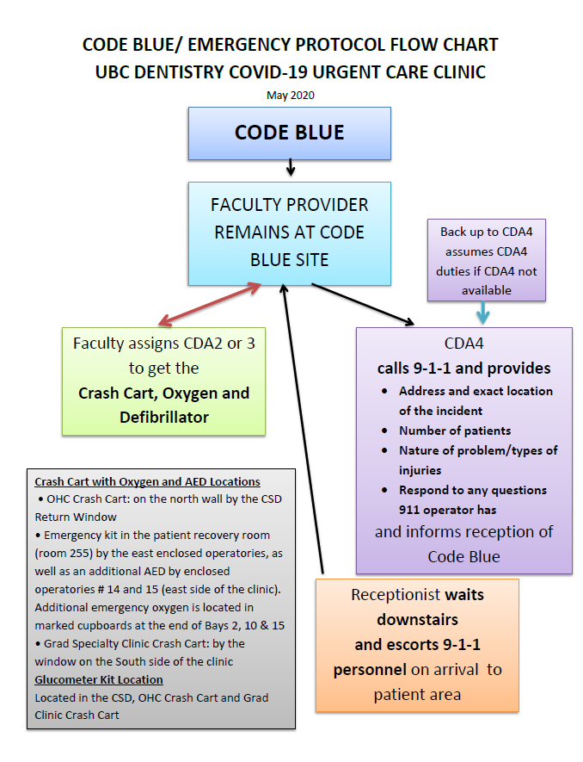
CODE BLUE/ EMERGENCY PROTOCOL
(May 18, 2020)
Notes:
Question to Dr. Esteves and Kathy: Do we need to create different code blue protocols for each clinic location for the programs working? (as we are working separately). Protocol for Patterson definitely needed. Protocol for JBM clinic needs to be looked into. Kathy to look into safety protocols – where the fire extinguishers are, etc. Plus orientation is needed.

Slide 38
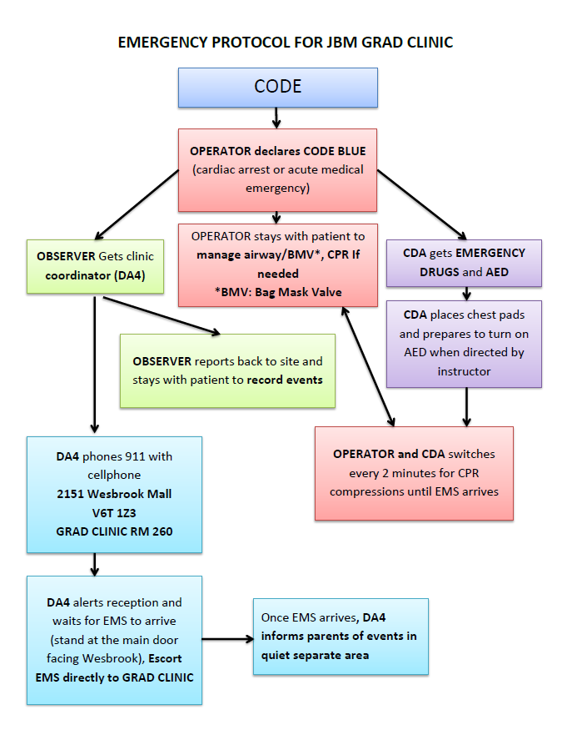
CODE BLUE/ EMERGENCY PROTOCOL
For JBM GRAD CLINIC

Slide 39
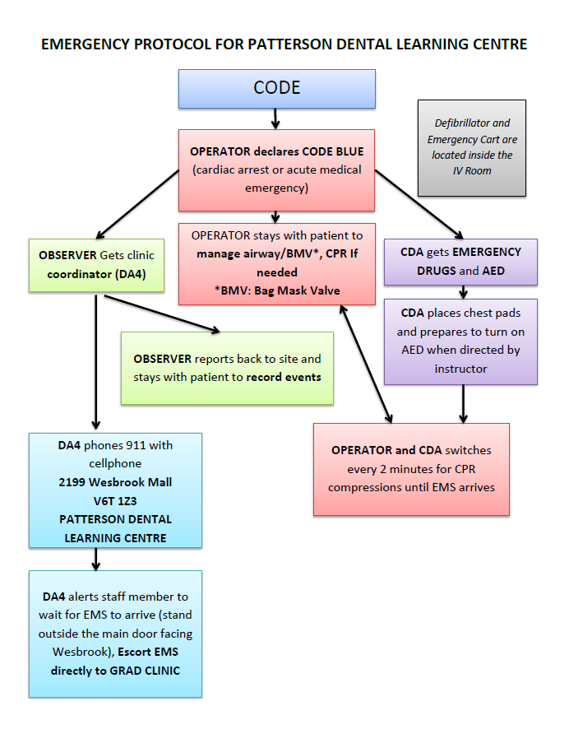
CODE BLUE/ EMERGENCY PROTOCOL
For Patterson Dental Learning Centre
Notes:
Not finalized – needs to be reviewed by Dr. Esteves, Miriam and Grad Perio Team and Kathy

Slide 40
Urgent Care Clinic
COVID-19 Protocol
DMD and Geriatric Programs

Slide 41
Appointment Booking Flow
Student Initial Assessment of Required Care Over Phone/E-mail
Patients experiencing pain or other discomfort are to contact their assigned student. The student is to review the situation to help determine the level of care required and to screen the patient for acute respiratory infection risk.
The student is to determine the nature of the problem and its characteristics. The type of care required is to be aligned with the definitions provided by the College of Dental Surgeons of BC (see next page)
Patient Screening for Acute Respiratory Illness
  The patient must be screened for acute respiratory illness, including COVID-19:
    Presence of fever
    Cough
    Difficulty breathing or Shortness of Breath
    Sore throat
    Runny nose
    Sneezing
    Post-nasal drip (coryza), loss of smell (anosmia) with or without fever
  AND any of the following:
    Returned from travel to any country or outside of Canada in the last 14 days; OR
    Close contact with a confirmed or probable case of COVID-19; OR
    Close contact with a person with acute respiratory illness who has returned from travel to an impacted area
Student is to then contact the designated faculty member to discuss the case and get orientation
The faculty member decides if the patient needs an appointment in the clinic. Otherwise, the faculty member will provide the patient with prescription and/or instructions
If an appointment is required, the Front Desk to be advised via email dentalclinic@dentistry.ubc.ca the patient’s information, type of appointment required and the amount of time necessary.

Slide 42
Reception Duties
  Direct any requests for appointments to Dr. Esteves first.
  Provide detailed information regarding the appointments scheduled:
    Tooth or teeth number being treated
    Planned procedure, for example: Open and drain 3-5 with sectioning of bridge or complex extraction 1-6
    Names of providers and their contact information
    Allow extra time for appointments since an examination and x-rays have to be performed, not just treatment
    Schedule appointments as EARLY as possible.
    Contact dentist and resident the day before to advise of appointments scheduled.
    Reception Staff should be present at the front desk to receive calls and support patient care during business hours.
Contact patients, providers and residents before the appointment.
    Contact patients the day before to ask health history questions regarding COVID based on screening form and to confirm the appointment Please ask the patient to bring their own mask and to wear it at all times. (6/4/2020)
    Ask if they have had symptoms or anyone in their household has had these symptoms
    Cough
    Breathing difficulties or shortness of breath, or at least 2 of these symptoms
    Fever
    Muscle pain
    Headaches in the last 14 days
    Chills, Repeated shaking with chills
    Runny Nose
    Sneezing
    Sore throat, New loss of taste or smell with or without fever
  Or any of the following
    Returned from travel to any country or outside of Canada in the last 14 days; OR
    Close contact with a confirmed or probable case of COVID-19; OR
    Close contact with a person with acute respiratory illness who has returned from travel to an impacted area
  Ask if they are taking any medication like Tylenol (Acetaminophen), Advil (Ibuprofen) or any NSAID (nonsteroidal anti-inflammatory drug) or Aspirin?

Slide 43
Reception Duties (Continued)
Contact patients, providers and residents before the appointment.
Advise Faculty provider if patient has COVID concerns and cancel the appointment or refer to another facility as needed
Advise Faculty provider if patient is taking any of the above medications as this will bring down fever
Ask patient to bring credit card or bank card to pay by tap and not cash
Ask patient to bring a minimum of personal items to their appointment (6/4/2020)
Advise patient of previous treatment balance if any
Remind patient that they will be charged accordingly per DMD or FPC fees
Advise patient to call in when they arrive - inquire whether they are taking their car or transit and if they have mobility issues…
Advise patient to sit in their car while waiting for appointment as it is recommended to only have one patient in the reception area at this time.
Direct patient who take transit or has mobility issues to specific waiting area if prior appointment is running late or if they are early and are uncomfortable waiting outside
Call patient to ask them to come to the entrance at time of appointment
Call patient to advise if provider is running late, and inform patient of possibility of appointment running late beforehand (cite unknown elements since all appointments are emergency visits)
Advise patient paid parking is available under the building (UBC parking changes effective 5/4/2020)
Advise patient to phone and inform the clinic if they will be late and that they may have to reschedule if they are late
Process treatment fees and report to any concerns to Dr. Esteves.
  Inform Dr. Esteves if an urgent care patient has an outstanding balance before the visit.
  All patients from the programs will be charged fees of the program.
  Familiarity with treatment codes is helpful, however:
    If treatment is not posted immediately, receptionist can phone patient regarding fees
    Refer to Dr. Esteves if concerns with treatment codes
    Dr. Esteves can assess if emergency has been caused by ongoing treatment and if this will affect fees to be charged to the patient

Slide 44
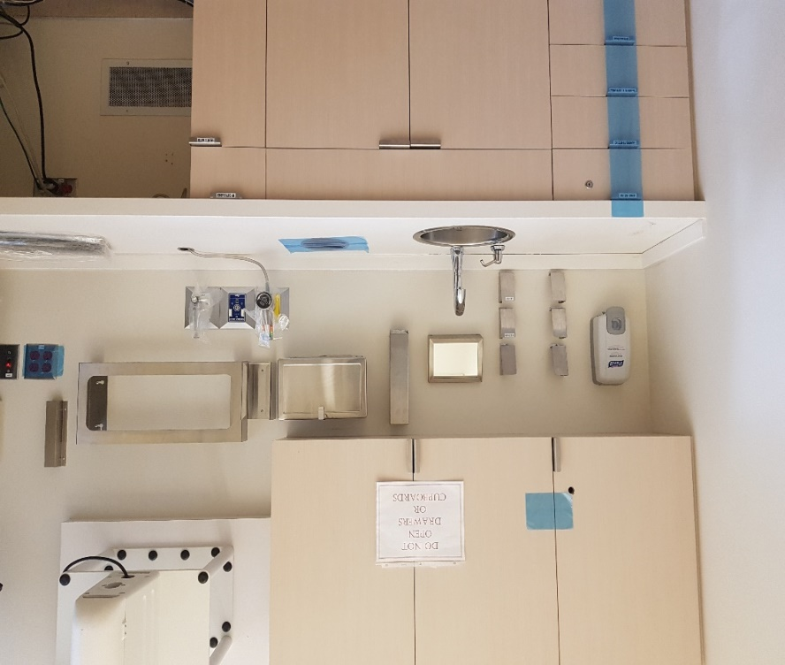
Preparation of Operatories
Clinic Operations and Protocol
Disinfect and prepare enclosed operatories. See photos for examples of closed operatory set-up.
Use large overgloves to cover mouse and the two wall fixtures.
Use x-ray barrier bag to cover the two monitors, the keyboard, the phone and x-ray head.
Use dental chair barriers to cover operator chair, patient chair, kidney table and microscope.
Use chair cover (not steridrapes) to cover handpiece unit. Steridrapes have been removed from the PPE cart.
Cover garbage opening on counter
Put lined biohazard bag into operatory.

Slide 45
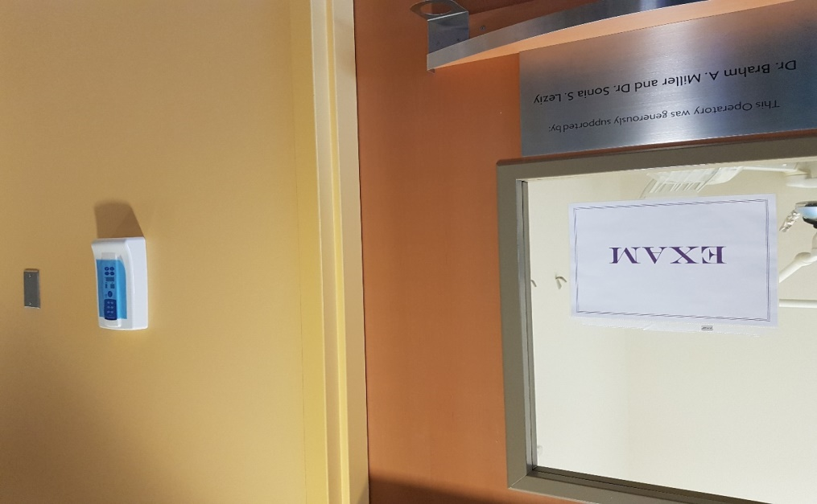
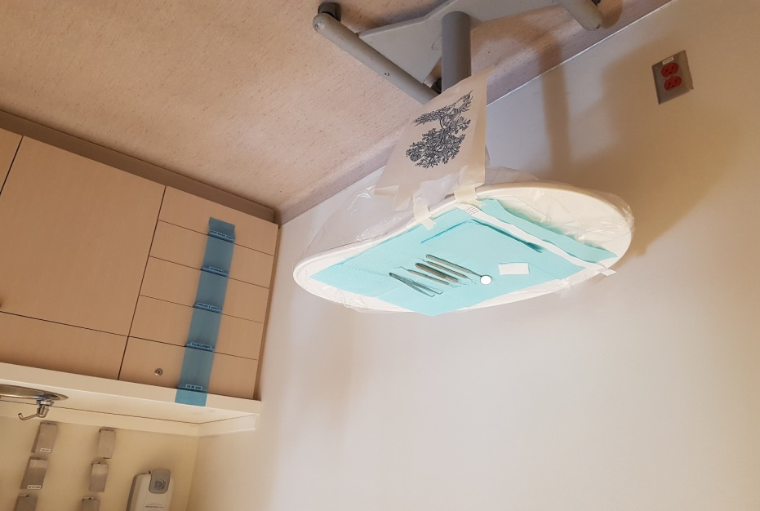
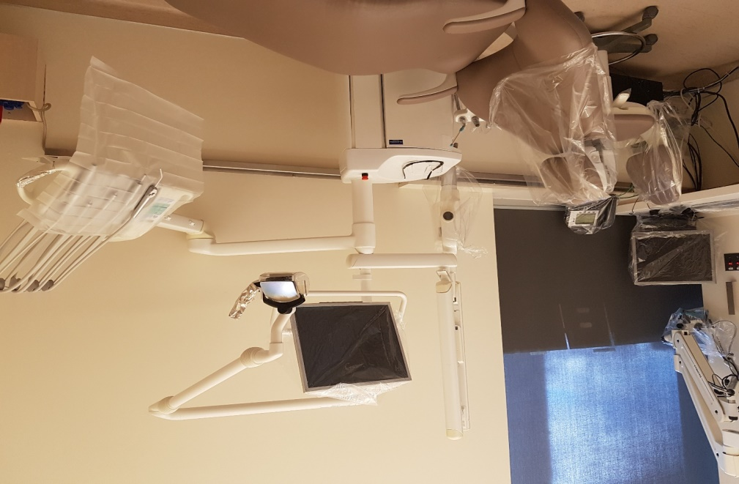
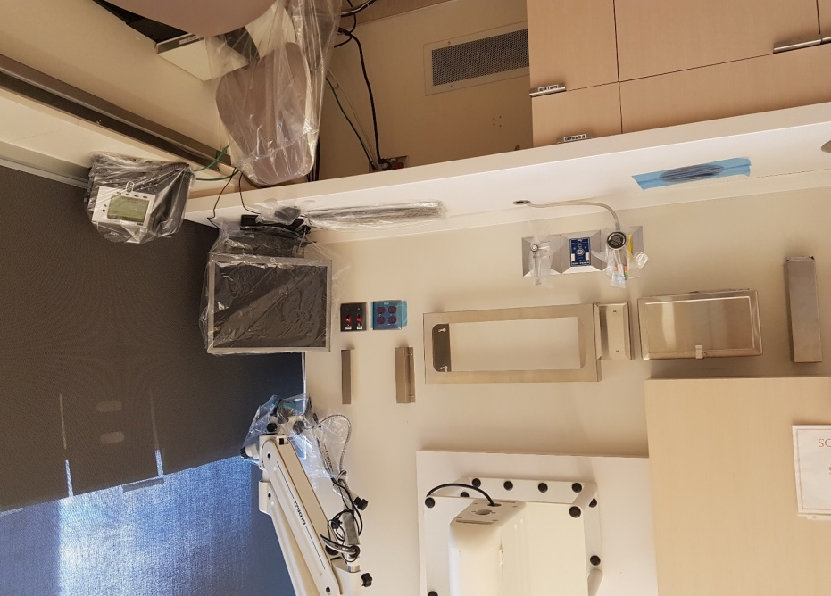
Preparation of Operatories
Do not use steridrape
Instead use chair cover barrier
to cover handpiece unit

Slide 46
Sundries and Supply Carts
Prepare and stock; replenish as items taken
Infection Control Cart
PPE Cart
Chair covers
X-ray bags
Foil
Patient packs
Blue barrier film rolls
Large overgloves
Paper bags
Optim wipes
Cavicide spray
Masking tape
Scissors
Preprocedural rinse
Tempodot or digital thermometer
Patient drapes
Disposable bib chains
Safety glasses
White gowns (Impervious gowns)
Yellow fluid resistant gowns – reg and xlarge
Disposable faceshields
Nonlatex gloves – small, medium and large
Bouffant hair caps
Level 3 fogshield masks
Optim wipes
Chair Covers
Shoe Covers

Slide 47
Sundries and Supply Carts
Prepare and stock; replenish as items taken
General & Pros
X-ray Cart
Exam kit
Basket with prescription pads, pens, note paper
Basket with separate mirrors, explorers, cotton pliers, hand mirrors
Endo ice
Floss
Occlude
Vaseline
Mixing pads
2x2s
Cotton tip applicator
Articulation paper and forceps
Tooth Slooth
Resto handpiece kits
Straight handpiece
Electric handpiece
Acrylic adjustment blocks
Resto bur blocks
Composite finish bur blocks
Removable appliance kit
3 BP monitors
Clip board and paper
Lead apron
PSPs Size 1 and 2s
RINNS – anterior, posterior and endo
Snap-A-Ray
Bite Wing Tabs
CCD sensors
Special Needs (June 4, 2020)
Provide customization if requested by provider as this will support a more efficient and faster treatment for the patient

Slide 48
Sundries and Supply Carts
Prepare and stock; replenish as items taken
Oral Surgery & Periodontics
*Please note Oral Surgery carts are unlocked if supplies are needed – 5/6/2020
Surgical consent forms and postop forms
OS trays
Perio Abscess Tray
Electric handpiece
Surgical handpiece with coupler and burs/white hose barriers
Anesthetic syringe
Saline with metal cups
Monoject syringes
Blade handles + 15 blades
3-0 gut suture
Surgical suction
Periosteal elevator
Surgical curette
Miscellaneous scalers
Root tip picks
Straight elevator
Potts
Cryers
Miscellaneous forceps
Bite blocks
Suction tubing
Scissors
Needle drivers
Dry socket paste
Paper mixing pad and spatula
Gelfoam
Surgicel
Bite blocks
Sterile 2x2 gauze
Paroex
Extra long surgical burs – added 5/8/2020

Slide 49
Sundries and Supply Carts
Prepare and stock; replenish as items taken
Endodontics
Open and drain
Endo cassettes
Rubber dam
Resto HP kits
Titrator
EPT and tips
Apex locator and tips
Local anesthetic: 2% lidocaine 1:100, 000 epinephrine, 4% articaine 1:200, 000 epinephrine, 3% mepivacaine
Anesthetic needles: 27 gauge long, 30 gauge short
Topical anesthetic
Alcohol
Plastic cups – small and large
6% sodium hypochlorite
10 ml syringes
Endo irrigation needles
Paper points – fine, medium and coarse
Cotton pellets
Cotton rolls
2 x 2 gauze
Endo bur blocks
Endo rings and sponges
Latex free rubber dam
Fuji IX kit and material
Photac kit and material
Calcium hydroxide syringe with navi tips
Cavit
Curing light and/or tip (per suggestion of Vivienne April 9)
Rotary handpiece
Rotary files

Slide 50
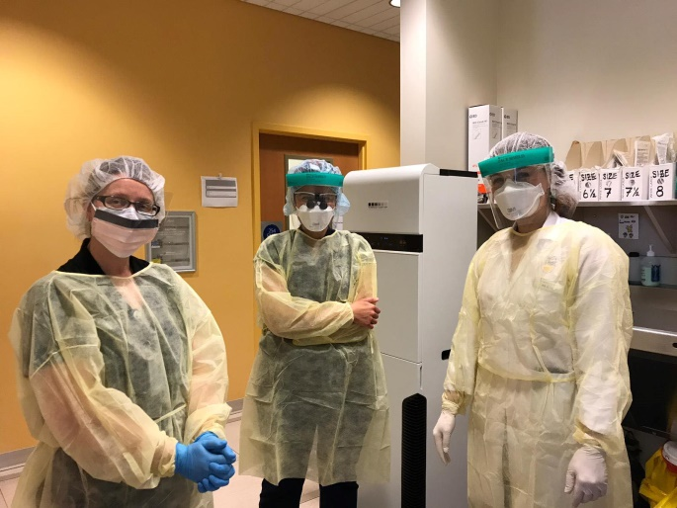
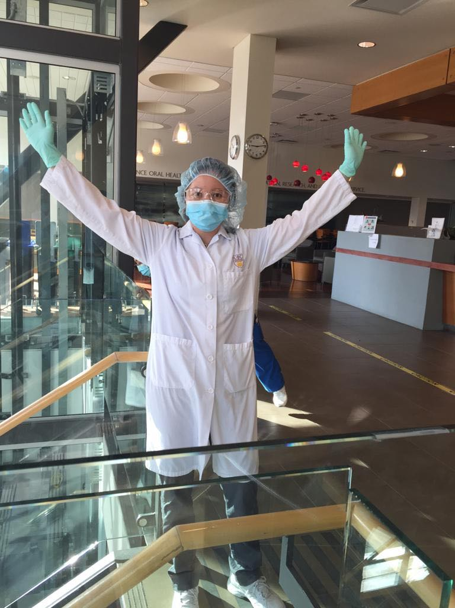
CDA Team Duties
DA4 part of clinical team must be present and participate in clinical duties
DA4 completes summary report in binder
DA4 sends an e-mail (template provided) to next day’s DA4 and Spare with Summary of Concerns if any
Redirect any appointment requests to Dr. Esteves
Print and post sign on operatory with procedure and operators especially if multiple operators on the same day
Duties are assigned to each team member. Specific notes for CDA Greeter/Triage in later slide.
Inform Tech if assistance needed with clinic equipment.
Disinfect and replenish temperature taking station/cart after each use.
Prepare operatory and armamentaria as per Faculty instructions.
Follow instructions in protocol for set-up of rooms
Mock-ups at 7:30 am as needed
Morning Huddle 15-20 minutes before first appointment to include Receptionist and Providers if their schedule permits
Provide the lined biohazard bucket inside the operatory for disposal of medical waste.

Slide 51
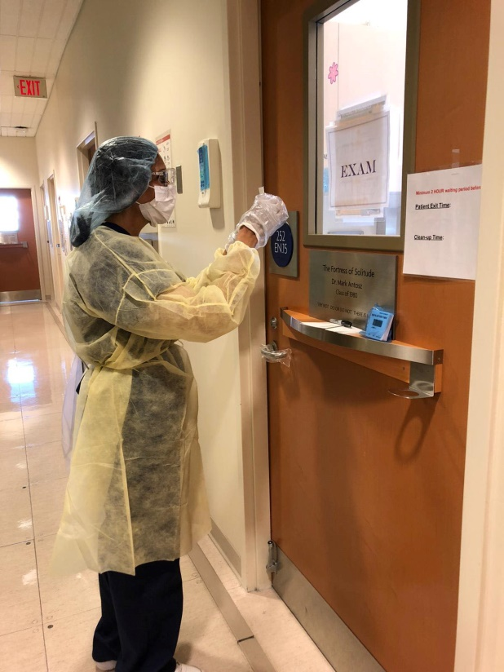
CDA Team Duties
Provide guidance to Dentist and Students when donning and doffing PPE. Best to show posters provided in clinic. Follow order for donning and doffing as recommended.
  Ensure that Dentist Doff ALL PPE INSIDE treatment room except for faceshield, mask and bouffant since observing contact and droplet precautions (cannot leave the room until all PPE Doffed) with required hand hygiene (6/11/2020)
No PPE required if work involved does not have contact with patients unless disinfecting treatment rooms
Circulating duties
  Process PSPs as requested by Faculty
  Provide Instruments and equipment needed by Faculty
  Determines if 2nd room is needed and makes preparations as needed
Communicate with providers by writing on blank cards and holding cards at door window
Observe and record time treatment is completed and wait 30 minutes before any cleaning and disinfecting operatory (6/4/2020)
Disinfect treatment rooms after use
Dispose of medical waste
Prepare room for next appointment as needed/time permitting
Replenish supplies in carts as needed

Slide 52
Technicians, Stores and Custodian Duties
Technicians & Custodians
Stores
All communication for Techs and Custodians through Ben
Techs responsible for maintaining air purifier and it should be left running all the time
Per Dr. Esteves on 5/3/2020, air purifier remains on all the time during the week. It is turned off on Friday and on again on Monday. Techs will be performing weekly maintenance of the waterlines every Monday before 8:30 am (Ben and Michele 5/8/2020)
Ben will inform Techs not to let patients without an appointment into the clinic (5/8/2020)
Techs to check-in with DA4 every morning before patient appointments to check on equipment and operatories for concerns
Custodians working their usual hours and following CDC protocol as per Dr. Esteves
Keenan monitoring and bringing up biohazard buckets as they arrive and storing them in lab across CSD-R
Standing order of biohazard buckets increased to 30 buckets per week (6/2020)
Keenan monitoring inventory at Stores

Slide 53
CODE BLUE/ EMERGENCY PROTOCOL
(May 18, 2020)
Notes:
Question to Dr. Esteves and Kathy: Do we need to create different code blue protocols for each clinic location for the programs working? (as we are working separately). Protocol for Patterson definitely needed. Protocol for JBM clinic needs to be looked into. Kathy to look into safety protocols – where the fire extinguishers are, etc. Plus orientation is needed.

